Slide 1
CS 3305A
Operating Systems (OS) Introduction
Lecture 2
Sept 11, 2019

Slide 2
Operating System (OS)
What is an Operating Systems (OS)?
  The software layer between user applications and hardware
  Manages / Optimizes the hardware resources
Brief History of OS:
  First generation: 1945 – 1955
    Vacuum tubes and plug boards
  Second generation: 1955 – 1965
    Transistors; Batch systems
  Third generation: 1965 – 1980
    Integrated circuits. Multiprogramming

Slide 3
Operating System (OS)
Fourth generation: 1980 – present
  Large scale integration. Personal computers.
Next generation:
  Systems connected by high-speed networks
  Wide area resource management

Slide 4
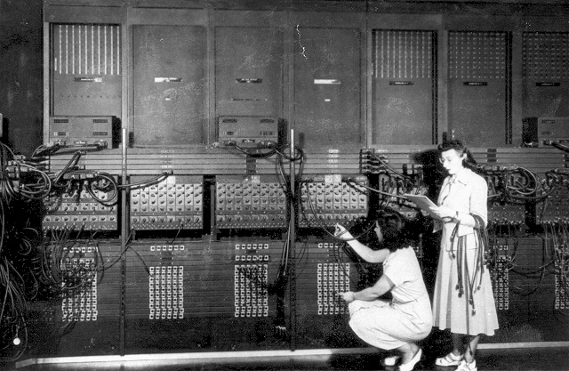
First Generation (1945-1955): Direct Input
Run one job at a time
  Enter it into the computer (might require rewiring)
  Run it
  Record the results
Programming languages were unheard of
Assembly languages were not known
No reason for an OS
Eniac, 1945

Slide 5
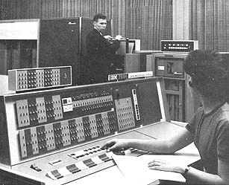
Second Generation (1955-1965): Batch Systems
Programs were written on paper in either FORTRAN or assembly
Programs encoded on punched cards
The card deck was taken down to the input room and handed to one of the operators
Programmer would come back later for results
IBM 7094/1401

Slide 6
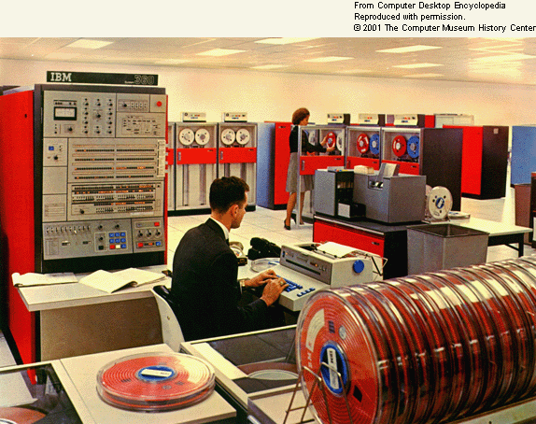
OS/360
A first example of an OS for this generation is IBM’s OS/360
Considered a landmark operating system

Slide 7

Third Generation: Multiprogramming (1965-1980)
Multiple jobs in memory
Protected from one another
Multiprogramming allowed several jobs to be active at one time

Slide 8
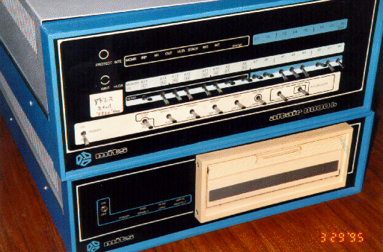
Fourth Generation (1980- present) Personal Computers
Personal computing changed the computing industry
Intel came out with the 8080 in 1974
Lots of companies produced complete systems
The Control Program for Microcomputers (CP/M) from Digital Research was used
Altair 8080, 1975
  256 bytes of memory

Slide 9
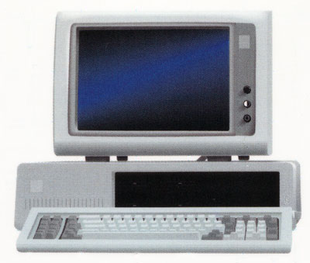
Fourth Generation (1980-present) Personal Computers
Now came the 16-bit systems with Intel’s 8086
IBM designed the IBM PC
IBM needed an OS for their PCs; CP/M behind schedule
Who did they turn to?
IBM PC, 1981
Retailed at $2880
64 kilobytes of RAM
Single-sided 160K 5.25 floppy drive

Slide 10
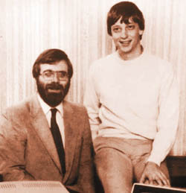
Fourth Generation (1980-present) Personal Computers
Bill Gates suggested to IBM that they should look at CP/M (one of the most successful OS for microcomputers at that time, by Gary Kindall)
CP/M deal was not successful

Slide 11
Fourth Generation (1980-) Personal Computers
IBM went back to Bill Gates
Gates offered an OS called DOS
DOS came from a company called Microsoft
The new OS was renamed MS-DOS

Slide 12
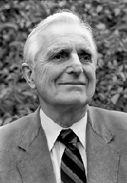
Fourth Generation (1980- present) Personal Computers
Up to this point all operating systems were command line
Doug Englehart at Stanford invented the Graphical User Interface (GUI)

Slide 13
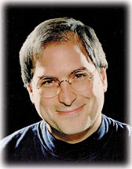
Fourth Generation (1980-present) Personal Computers
Steve Jobs saw the possibility of a user-friendly PC
This led to the Apple Macintosh in 1984

Slide 14
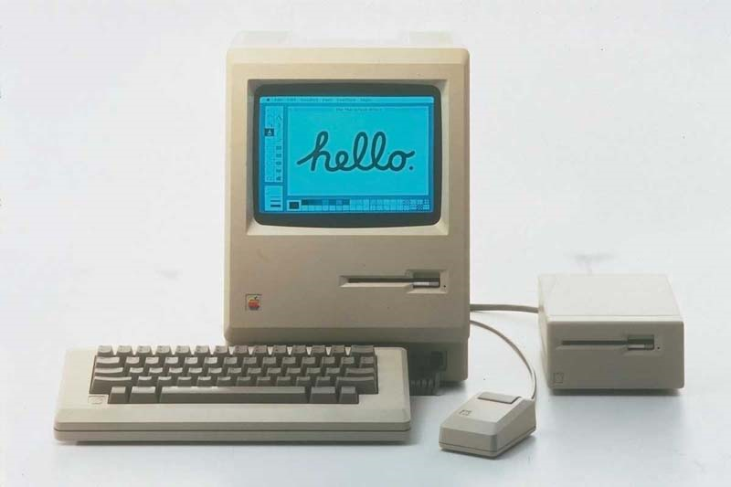
Fourth Generation (1980- present) Personal Computers
Used Motorola’s 16-bit 68000
64 KB of ROM
Of course it had the first GUI
BTW, Apple only started using Intel processors in 2006

Slide 15
What about UNIX?
Let’s go back to the 60’s
MULTICS was the first large timesharing system developed jointly between MIT, General Electric (computing division eventually sold to Honeywell) and Bell Labs
But,…. OS was written in a language called PL/1
Not a lot of these got sold but they were very popular with those who bought
Last one was put out of commission in 2000
  It was owned by the Canadian Department of National Defence

Slide 16
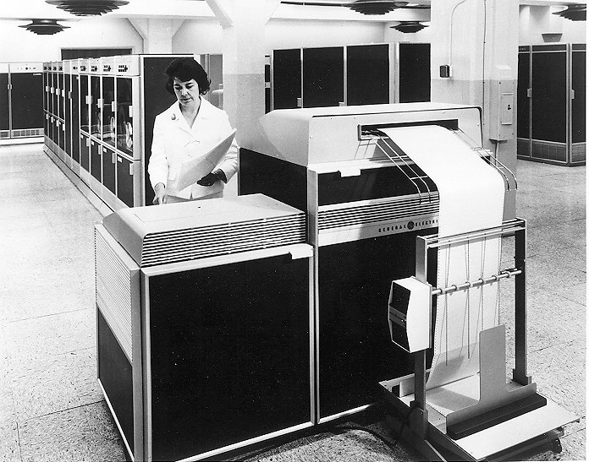
MULTICS

Slide 17
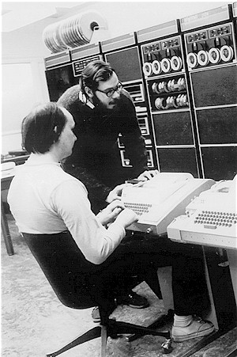
What about UNIX?
One of the computer scientists at Bell Labs who worked on MULTICS was Ken Thompson
He found a small PDP-7 minicomputer that no one was using
He decided to write a stripped-down, one-user version of MULTICS in the C programming language
This became UNIX.
This was open source which led to other versions: System V (AT&T) and BSD (Berkeley Software Distribution)

Slide 18
What about MINIX?
Eventually AT&T realized that UNIX was commercially viable
Unix, Version 7’s license prohibited the source code from being studied in courses
A computer scientist, Andrew Tanenbaum created a new OS (using the C programming language) from scratch that would be compatible with UNIX but completely different on the inside
This was MINIX or mini-Unix; released in 1987
Better structured than UNIX
MINIX-2 released in 1997
MINIX-3 released in 2006

Slide 19
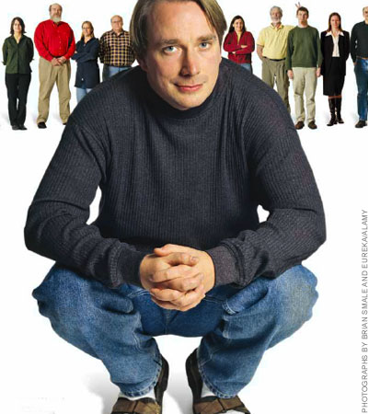
LINUX
After MINIX was released a newsgroup, comp.os.minix was formed.
Quickly had 40,000 subscribers who wanted to add stuff
One was a Finnish student named Linus Torvalds

Slide 20
LINUX
Torvalds wanted to add features which led to other things
Eventually this led to his own OS called Linux (August 1991)
Linux is a notable success of the open source movement

Slide 21
Summary
We have discussed what is an operating system
We have looked at a brief history of operating systems
Now it is time to learn more about the insides of an operating system

